Slide 1
IV4 Treatment on the Treated
UIUC ECON 474 Econometrics of Policy Evaluation

Slide 2
Overview
Read Mixtape Ch. 6.1 – 6.2.6
Today:
Instrumental variables in randomized experiments
Finkelstein et al. (2012) The Oregon Health Insurance Experiment
Coding: replicate parts of Finkelstein et al. (2012)

Slide 3
IV in Randomized Experiments
When compliance matters

Slide 4
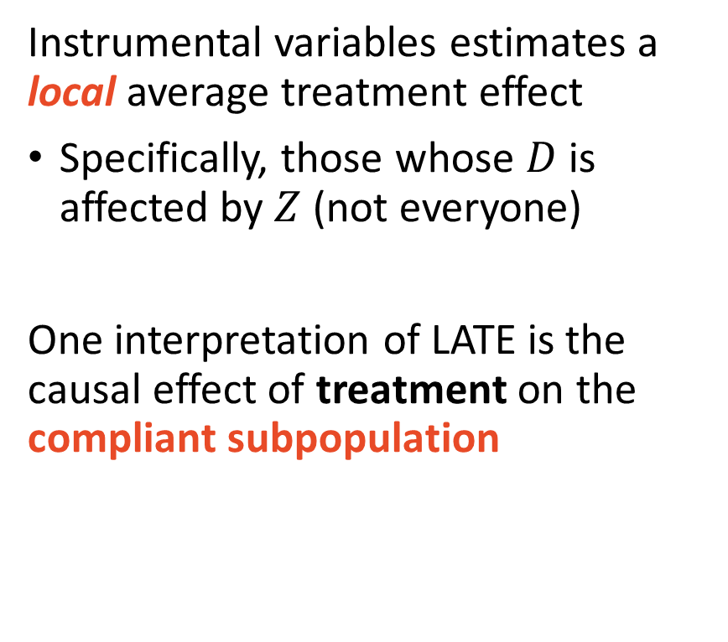
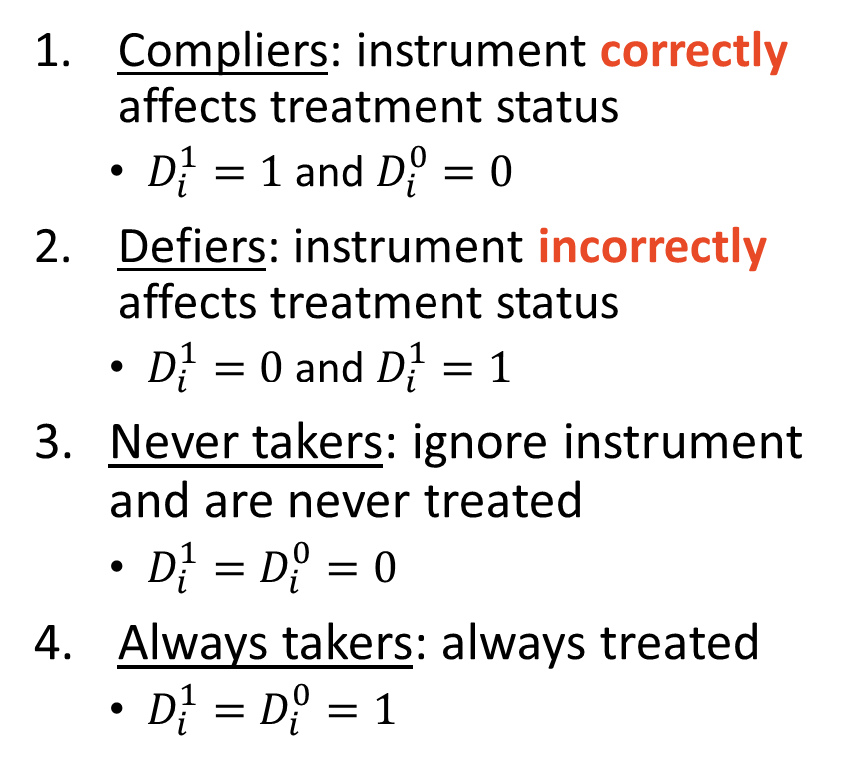
Recall from the previous lecture:
Compliers: instrument correctly affects treatment status
$D_{i}^{1}=1$ and $D_{i}^{0}=0$
Defiers: instrument incorrectly affects treatment status
$D_{i}^{1}=0$ and $D_{i}^{1}=1$
Never takers: ignore instrument and are never treated
$D_{i}^{1}=D_{i}^{0}=0$
Always takers: always treated
$D_{i}^{1}=D_{i}^{0}=1$
Instrumental variables estimates a local average treatment effect
Specifically, those whose $D$ is affected by $Z$ (not everyone)
One interpretation of LATE is the causal effect of treatment on the compliant subpopulation

Slide 5
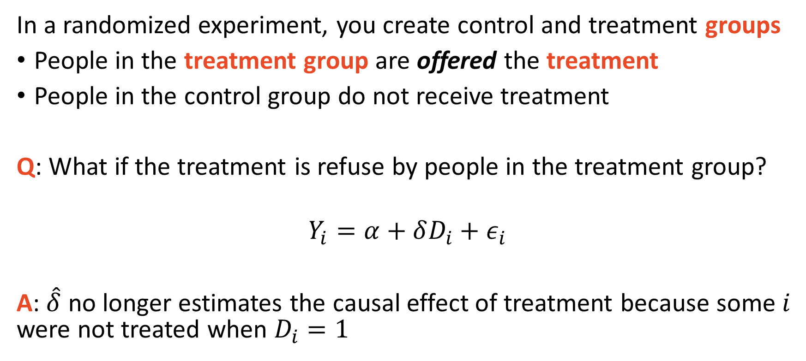
Noncompliance biases OLS causal estimates
In a randomized experiment, you create control and treatment groups
People in the treatment group are offered the treatment
People in the control group do not receive treatment
Q: What if the treatment is refuse by people in the treatment group?
$$Y_{i}=α+δD_{i}+ε_{i}$$
A: $\hat{δ}$ no longer estimates the causal effect of treatment because some $i$ were not treated when $D_{i}=1$

Slide 6
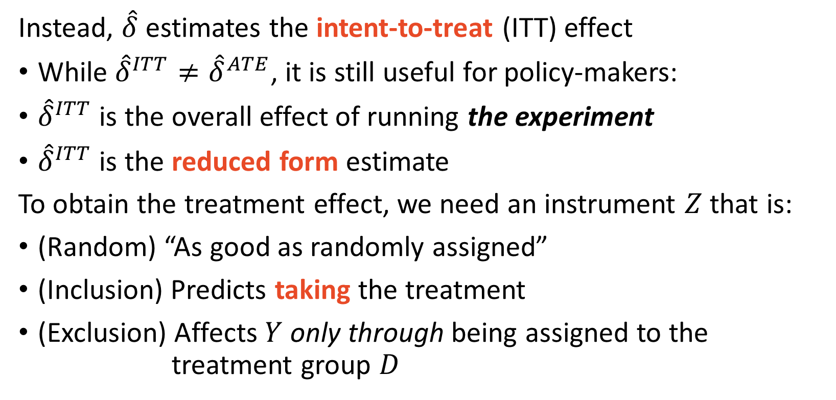
Non-compliance estimates are intent-to-treat effects
Instead, $\hat{δ}$ estimates the intent-to-treat (ITT) effect
While ${\hat{δ}}^{ITT}≠{\hat{δ}}^{ATE}$, it is still useful for policy-makers:
${\hat{δ}}^{ITT}$ is the overall effect of running the experiment
${\hat{δ}}^{ITT}$ is the reduced form estimate
To obtain the treatment effect, we need an instrument $Z$ that is:
(Random) “As good as randomly assigned”
(Inclusion) Predicts taking the treatment
(Exclusion) Affects $Y$ only through being assigned to the treatment group $D$

Slide 7
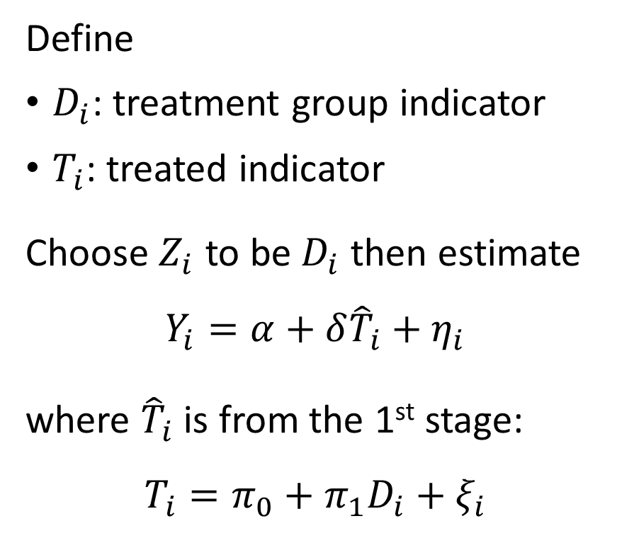
Treatment assignment is a valid IV for being treated
Candidate IV: being assigned to the treatment group
(Random) It is randomly assigned by definition
(Inclusion) Only people in the treatment group are offered treatment
(Exclusion) Group assignment is unconditional on the outcome
Define
$D_{i}$: treatment group indicator
$T_{i}$: treated indicator
Choose $Z_{i}$ to be $D_{i}$ then estimate
$$Y_{i}=α+δ{\hat{T}}_{i}+η_{i}$$
where ${\hat{T}}_{i}$ is from the 1st stage:
$$T_{i}=π_{0}+π_{1}D_{i}+ξ_{i}$$

Slide 8
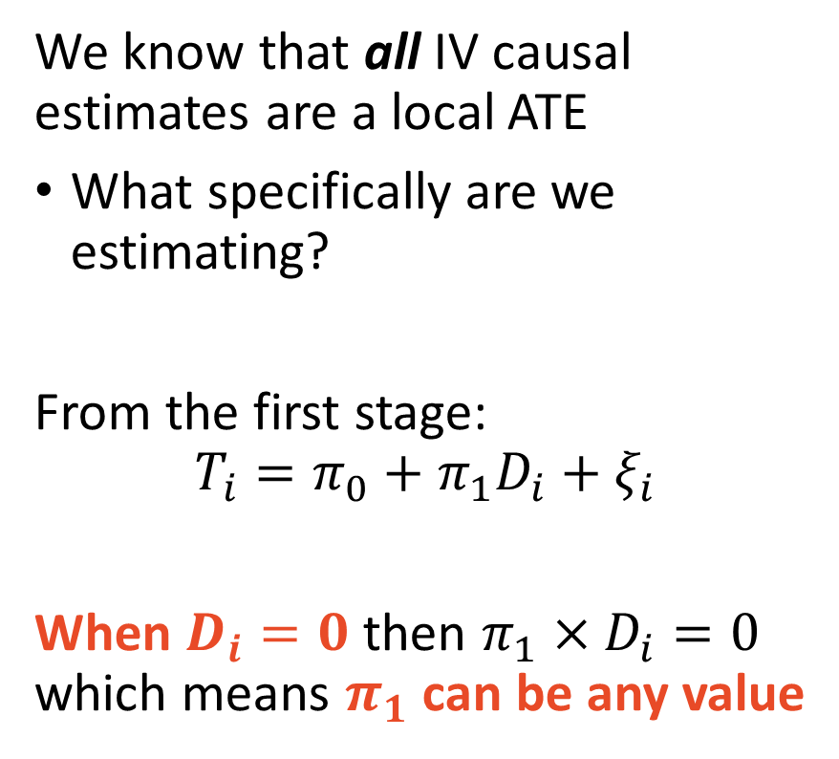
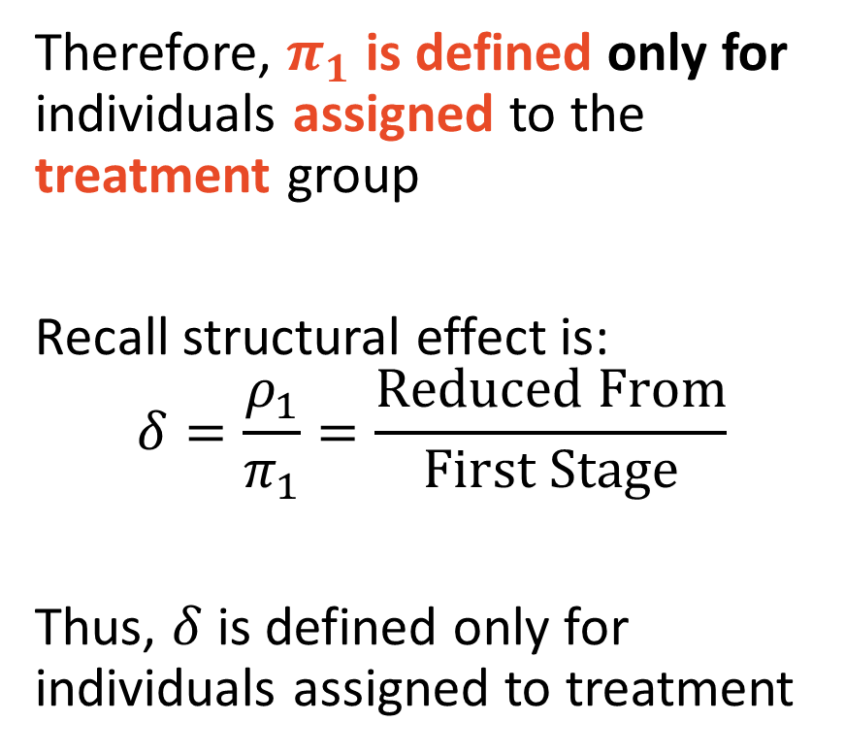
1st stage identified from $i$ being assigned treatment
We know that all IV causal estimates are a local ATE
What specifically are we estimating?
From the first stage:
$$T_{i}=π_{0}+π_{1}D_{i}+ξ_{i}$$
When $D_{i}=0$ then $π_{1}×D_{i}=0$ which means $π_{1}$ can be any value
Therefore, $π_{1}$ is defined only for individuals assigned to the treatment group
Recall structural effect is:
$$δ=\frac{ρ_{1}}{π_{1}}=\frac{Reduced From}{First Stage}$$
Thus, $δ$ is defined only for individuals assigned to treatment

Slide 9
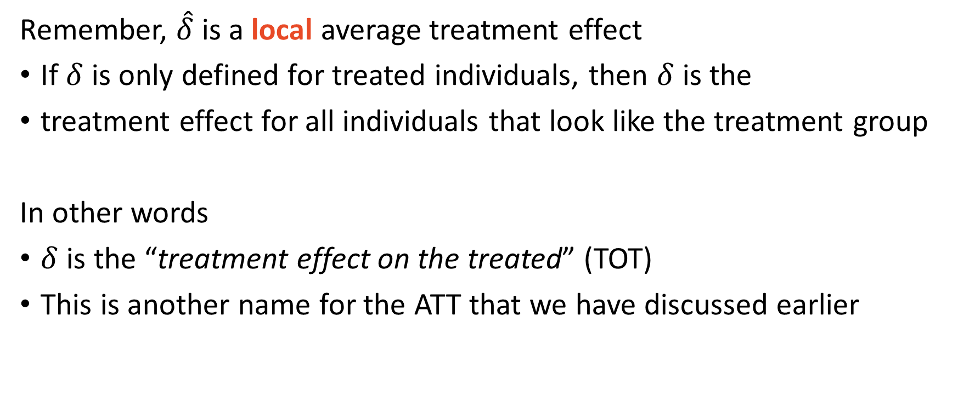
Treatment Effect on the Treated
Remember, $\hat{δ}$ is a local average treatment effect
If $δ$ is only defined for treated individuals, then $δ$ is the
treatment effect for all individuals that look like the treatment group
In other words
$δ$ is the “treatment effect on the treated” (TOT)
This is another name for the ATT that we have discussed earlier

Slide 10
Finkelstein et al. (2012) The Oregon Health Insurance Experiment
What are the effects of expanding health insurance access?

Slide 11
Finkelstein et al. (2012) overview
In 2008, the Oregon state Medicaid was full.
The state then opened a limited number slots to low-income, uninsured adults.
Due to few openings, adults were selected by a lottery
Not all selected adults received Medicaid
Importantly, it was impossible for non-selected adults to start receiving the Oregon state Medicaid
Results with one-sided non-compliance

Slide 12
Finkelstein et al. (2012) Findings
Compared to the control group, the treatment group:
Were 25 percentage points (not %) more likely to have insurance
Higher healthcare utilization
Lower out-of-pocket expenditures
Lower medical debt
Better self-reported physical health
Better self-reported mental health

